Slide 1
Chapter 1: Introduction

Slide 2
Outline
UNIT I
Introduction: Database system applications, database systems versus file systems, views of data, data models, database languages, database users and administrators, transaction management, database system structure, application architecture.
Data modeling using the Entity Relationship Model: ER model concepts, notation for ER diagram, mapping constraints, keys, concepts of super key, candidate key, primary key, unique key, generalization, aggregation, reduction of an ER diagram to tables.

Slide 3
Database
The database is a collection of inter-related data which is used to retrieve, insert and delete the data efficiently. It is also used to organize the data in the form of a table, schema, views, and reports, etc.
Using the database, you can easily retrieve, insert, and delete the information.
Databases can be very large.
For example: The college Database organizes the data about the admin, staff, students and faculty etc.

Slide 4
Database Management System (DBMS)
Database management system is a software which is
  used to manage the database.
  For example: MySQL, Oracle, etc are a very popular commercial database which is used in different applications.
DBMS contains information about a particular enterprise
  Collection of interrelated data
  Set of programs to access the data
  An environment that is both convenient and efficient to us
DBMS provides an interface to perform various operations like database creation, storing data in it, updating data, creating a table in the database etc.
It provides protection and security to the database. In the case of multiple users, it also maintains data consistency.

Slide 5
Database Management System (DBMS)
DBMS allows users the following tasks:
  Data Definition: It is used for creation, modification, and removal of definition that defines the organization of data in the database.
  Data Updation: It is used for the insertion, modification, and deletion of the actual data in the database.
  Data Retrieval: It is used to retrieve the data from the database which can be used by applications for various purposes.
  User Administration: It is used for registering and monitoring users, maintain data integrity, enforcing data security, dealing with concurrency control, monitoring performance and recovering information corrupted by unexpected failure.

Slide 6
DBMS Applications
Database Applications:
  Banking: transactions
  Airlines: reservations, schedules
  Universities: registration, grades
  Sales: customers, products, purchases
  Online retailers: order tracking, customized recommendations
  Manufacturing: production, inventory, orders, supply chain
  Human resources: employee records, salaries, tax deductions
In the early days, database applications were built directly on top of file systems

Slide 7
DBMS Applications University Database
Application program examples
  Add new students, instructors, and courses
  Register students for courses, and generate class rosters
  Assign grades to students, compute grade point averages (GPA) and generate transcripts

Slide 8
DBMS Characteristics
It uses a digital repository established on a server to store and manage the information.
It can provide a clear and logical view of the process that manipulates data.
DBMS contains automatic backup and recovery procedures.
It contains ACID properties which maintain data in a healthy state in case of failure.
It can reduce the complex relationship between data.
It is used to support manipulation and processing of data.
It is used to provide security of data.
It can view the database from different viewpoints according to the requirements of the user.

Slide 9
Disadvantages of DBMS
Cost of Hardware and Software: It requires a high speed of data processor and large memory size to run DBMS software.
Size: It occupies a large space of disks and large memory to run them efficiently.
Complexity: Database system creates additional complexity and requirements.
Higher impact of failure: Failure is highly impacted the database because in most of the organization, all the data stored in a single database and if the database is damaged due to electric failure or database corruption then the data may be lost forever.

Slide 10
Advantages of DBMS
Controls database redundancy: It can control data redundancy because it stores all the data in one single database file and that recorded data is placed in the database.
Data sharing: In DBMS, the authorized users of an organization can share the data among multiple users.
Easily Maintenance: It can be easily maintainable due to the centralized nature of the database system.
Reduce time: It reduces development time and maintenance need.
Backup: It provides backup and recovery subsystems which create automatic backup of data from hardware and software failures and restores the data if required.
multiple user interface: It provides different types of user interfaces like graphical user interfaces, application program interfaces

Slide 11
DBMS vs. File System
DBMS | File System
DBMS is a collection of data. In DBMS, the user is not required to write the procedures. | File system is a collection of data. In this system, the user has to write the procedures for managing the database.
DBMS gives an abstract view of data that hides the details. | File system provides the detail of the data representation and storage of data.
DBMS provides a crash recovery mechanism, i.e., DBMS protects the user from the system failure. | File system doesn't have a crash mechanism, i.e., if the system crashes while entering some data, then the content of the file will lost.
DBMS provides a good protection mechanism. | It is very difficult to protect a file under the file system.
DBMS contains a wide variety of sophisticated techniques to store and retrieve the data. | File system can't efficiently store and retrieve the data.
DBMS takes care of Concurrent access of data using some form of locking. | In the File system, concurrent access has many problems like redirecting the file while other deleting some information or updating some information.

Slide 12
Drawbacks of using file systems to store data
Data redundancy and inconsistency
  Multiple file formats, duplication of information in different files
Difficulty in accessing data
  Need to write a new program to carry out each new task
Data isolation
  Multiple files and formats
Integrity problems
  Integrity constraints (e.g., account balance > 0) become “buried” in program code rather than being stated explicitly
  Hard to add new constraints or change existing ones
Security problems
  Hard to provide user access to some, but not all, data

Slide 13
Drawbacks of using file systems to store data (Cont.)
Atomicity of updates
  Failures may leave database in an inconsistent state with partial updates carried out
  Example: Transfer of funds from one account to another should either complete or not happen at all
Concurrent access by multiple users
  Concurrent access needed for performance
  Uncontrolled concurrent accesses can lead to inconsistencies
    Example: Two people reading a balance (say 100) and updating it by withdrawing money (say 50 each) at the same time
Database systems offer solutions to all the above problems

Slide 14

View of Data
An architecture for a database system

Slide 15
Levels of Abstraction
Physical level: describes how a record (e.g., instructor) is stored.
Logical level: describes data stored in database, and the relationships among the data.
  type instructor = record
  ID : string;
  name : string;
  dept_name : string;
  salary : integer;
        end;
View level: application programs hide details of data types. Views can also hide information (such as an employee’s salary) for security purposes.

Slide 16
Instances and Schemas
Similar to types and variables in programming languages
Logical Schema – the overall logical structure of the database
  Example: The database consists of information about a set of customers and accounts in a bank and the relationship between them
    Analogous to type information of a variable in a program
Physical schema– the overall physical structure of the database
Instance – the actual content of the database at a particular point in time
  Analogous to the value of a variable
Physical Data Independence – the ability to modify the physical schema without changing the logical schema
  Applications depend on the logical schema
  In general, the interfaces between the various levels and components should be well defined so that changes in some parts do not seriously influence others.

Slide 17
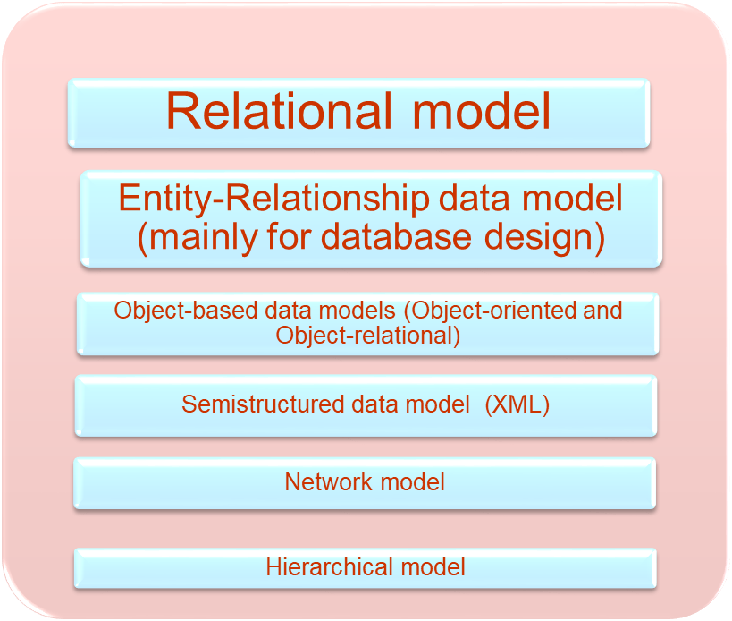
Data Models
Is a collection of tools for describing
  Data
  Data relationships
  Data semantics
  Data constraints

Slide 18

Relational Model
All the data is stored in various tables.
Example of tabular data in the relational model
Columns
Rows

Slide 19
A Sample Relational Database

Slide 20
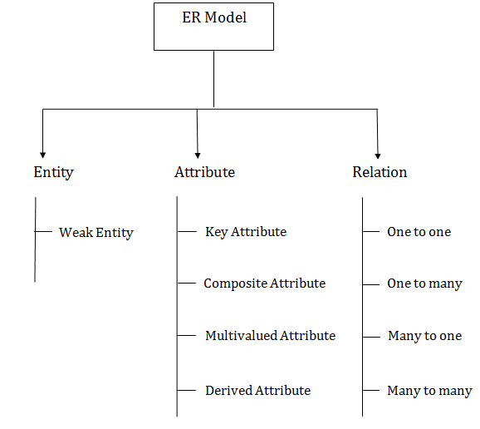
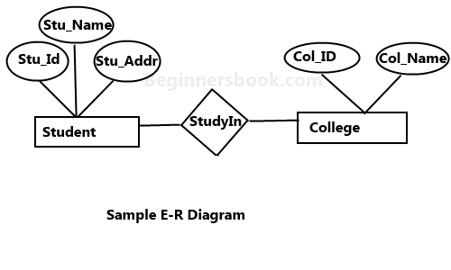
ER Diagram
Source: https://www.javatpoint.com/dbms-mapping-constraints

Slide 21

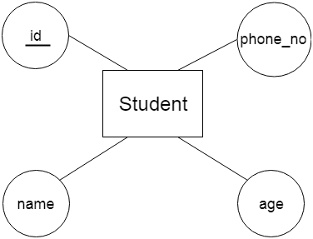
ER Diagram
a. Weak Entity
An entity that depends on another entity called a weak entity. The weak entity doesn't contain any key attribute of its own. The weak entity is represented by a double rectangle.
a. Key Attribute
The key attribute is used to represent the main characteristics of an entity. It represents a primary key. The key attribute is represented by an ellipse with the text underlined.

Slide 22
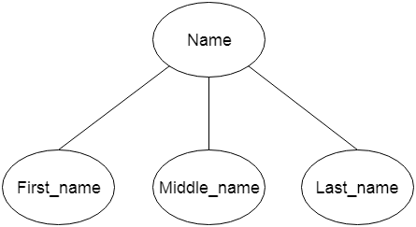
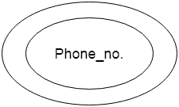
ER Diagram
b. Composite Attribute
An attribute that composed of many other attributes is known as a composite attribute. The composite attribute is represented by an ellipse, and those ellipses are connected with an ellipse.
c. Multivalued Attribute
An attribute can have more than one value. These attributes are known as a multivalued attribute. The double oval is used to represent multivalued attribute.
For example, a student can have more than one phone number.

Slide 23
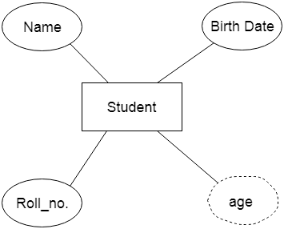
ER Diagram
d. Derived Attribute
An attribute that can be derived from other attribute is known as a derived attribute. It can be represented by a dashed ellipse.
For example, A person's age changes over time and can be derived from another attribute like Date of birth.

Slide 24



ER Diagram
3. Relationship
A relationship is used to describe the relation between entities. Diamond or rhombus is used to represent the relationship.
a. One-to-One Relationship
When only one instance of an entity is associated with the relationship, then it is known as one to one relationship.
For example, A female can marry to one male, and a male can marry to one female.
b. One-to-many relationship
When only one instance of the entity on the left, and more than one instance of an entity on the right associates with the relationship then this is known as a one-to-many relationship.
For example, Scientist can invent many inventions, but the invention is done by the only specific scientist.

Slide 25


ER Diagram
c. Many-to-one relationship
When more than one instance of the entity on the left, and only one instance of an entity on the right associates with the relationship then it is known as a many-to-one relationship.
For example, Student enrolls for only one course, but a course can have many students.
d. Many-to-many relationship
When more than one instance of the entity on the left, and more than one instance of an entity on the right associates with the relationship then it is known as a many-to-many relationship.
For example, Employee can assign by many projects and project can have many employees.

Slide 26
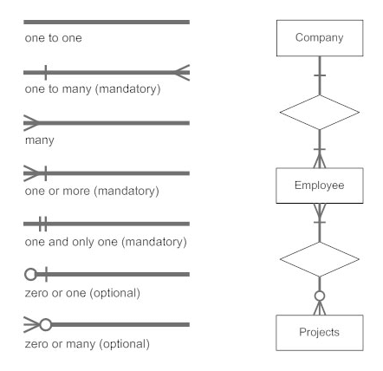
ER Diagram

Slide 27
Question
Create a ER diagram of any application you find in your environment.

Slide 28
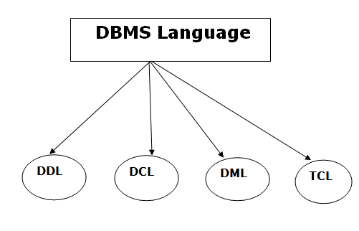
Database Language

Slide 29
Database Language
Data Definition Language
DDL stands for Data Definition Language.
It is used to define database structure or pattern.
It is used to create schema, tables, indexes, constraints, etc. in the database.
Using the DDL statements, you can create the skeleton of the database.
Data definition language is used to store the information of metadata like the number of tables and schemas, their names, indexes, columns in each table, constraints, etc.
Here are some tasks that come under DDL:
Create: It is used to create objects in the database.
Alter: It is used to alter the structure of the database.
Drop: It is used to delete objects from the database.
Truncate: It is used to remove all records from a table.
Rename: It is used to rename an object.
Comment: It is used to comment on the data dictionary.
These commands are used to update the database schema that's why they come under Data definition language.

Slide 30
Data Definition Language (DDL)
Specification notation for defining the database schema
  Example: create table instructor (
  ID char(5),
  name varchar(20),
  dept_name varchar(20),
  salary numeric(8,2))
DDL compiler generates a set of table templates stored in a data dictionary
Data dictionary contains metadata (i.e., data about data)
  Database schema
  Integrity constraints
    Primary key (ID uniquely identifies instructors)
  Authorization
    Who can access what

Slide 31
Database Language
Data Manipulation Language
DML stands for Data Manipulation Language. It is used for accessing and manipulating data in a database. It handles user requests.
Here are some tasks that come under DML:
Select: It is used to retrieve data from a database.
Insert: It is used to insert data into a table.
Update: It is used to update existing data within a table.
Delete: It is used to delete all records from a table.
Merge: It performs UPSERT operation, i.e., insert or update operations.
Call: It is used to call a structured query language or a Java subprogram.
Explain Plan: It has the parameter of explaining data.
Lock Table: It controls concurrency.

Slide 32
Data Manipulation Language (DML)
Language for accessing and manipulating the data organized by the appropriate data model
  DML also known as query language
Two classes of languages
  Pure – used for proving properties about computational power and for optimization
    Relational Algebra
    Tuple relational calculus
    Domain relational calculus
  Commercial – used in commercial systems
    SQL is the most widely used commercial language

Slide 33
Database Language
Data Control Language
DCL stands for Data Control Language. It is used to retrieve the stored or saved data.
The DCL execution is transactional. It also has rollback parameters.
(But in Oracle database, the execution of data control language does not have the feature of rolling back.)
Here are some tasks that come under DCL:
Grant: It is used to give user access privileges to a database.
Revoke: It is used to take back permissions from the user.
There are the following operations which have the authorization of Revoke:
CONNECT, INSERT, USAGE, EXECUTE, DELETE, UPDATE and SELECT.

Slide 34
Database Language
Transaction Control Language
TCL is used to run the changes made by the DML statement. TCL can be grouped into a logical transaction.
Here are some tasks that come under TCL:
Commit: It is used to save the transaction on the database.
Rollback: It is used to restore the database to original since the last Commit.

Slide 35
SQL
The most widely used commercial language
SQL is NOT a Turing machine equivalent language
SQL is NOT a Turing machine equivalent language
To be able to compute complex functions SQL is usually embedded in some higher-level language
Application programs generally access databases through one of
  Language extensions to allow embedded SQL
  Application program interface (e.g., ODBC/JDBC) which allow SQL queries to be sent to a database

Slide 36
Database Design
The process of designing the general structure of the database:
Logical Design – Deciding on the database schema. Database design requires that we find a “good” collection of relation schemas.
  Business decision – What attributes should we record in the database?
  Computer Science decision – What relation schemas should we have and how should the attributes be distributed among the various relation schemas?
Physical Design – Deciding on the physical layout of the database

Slide 37

Database Design (Cont.)
Is there any problem with this relation?

Slide 38
Design Approaches
Need to come up with a methodology to ensure that each of the relations in the database is “good”
Two ways of doing so:
  Entity Relationship Model (Chapter 7)
    Models an enterprise as a collection of entities and relationships
    Represented diagrammatically by an entity-relationship diagram:
  Normalization Theory (Chapter 8)
    Formalize what designs are bad, and test for them

Slide 39
Object-Relational Data Models
Relational model: flat, “atomic” values
Object Relational Data Models
  Extend the relational data model by including object orientation and constructs to deal with added data types.
  Allow attributes of tuples to have complex types, including non-atomic values such as nested relations.
  Preserve relational foundations, in particular the declarative access to data, while extending modeling power.
  Provide upward compatibility with existing relational languages.

Slide 40
XML: Extensible Markup Language
Defined by the WWW Consortium (W3C)
Originally intended as a document markup language not a database language
The ability to specify new tags, and to create nested tag structures made XML a great way to exchange data, not just documents
XML has become the basis for all new generation
data interchange formats.
A wide variety of tools is available for parsing, browsing and querying XML documents/data

Slide 41

Database System Internals
Database Engine
Storage manager
Query processing
Transaction manager

Slide 42

Database Users and Administrators

Slide 43
Storage Management
Storage manager is a program module that provides the interface between the low-level data stored in the database and the application programs and queries submitted to the system.
The storage manager is responsible to the following tasks:
  Interaction with the OS file manager
  Efficient storing, retrieving and updating of data
Issues:
  Storage access
  File organization
  Indexing and hashing

Slide 44

Query Processing
1. Parsing and translation
2. Optimization
3. Evaluation

Slide 45
Query Processing (Cont.)
Alternative ways of evaluating a given query
  Equivalent expressions
  Different algorithms for each operation
Cost difference between a good and a bad way of evaluating a query can be enormous
Need to estimate the cost of operations
  Depends critically on statistical information about relations which the database must maintain
  Need to estimate statistics for intermediate results to compute cost of complex expressions

Slide 46
Transaction Management
What if the system fails?
What if more than one user is concurrently updating the same data?
A transaction is a collection of operations that performs a single logical function in a database application
Transaction-management component ensures that the database remains in a consistent (correct) state despite system failures (e.g., power failures and operating system crashes) and transaction failures.
Concurrency-control manager controls the interaction among the concurrent transactions, to ensure the consistency of the database.

Slide 47
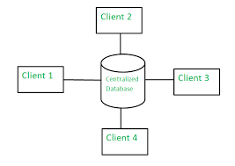
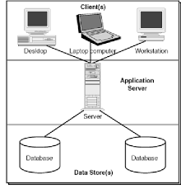
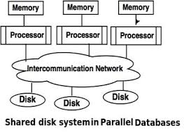
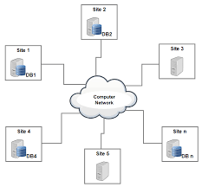
Database Architecture
Architecture of a database systems is greatly influenced by the underlying computer system on which the database is running
Centralized
Client-server
Distributed
Parallel (multi-processor)

Slide 48
Keys in DBMS
KEYS in DBMS
is an attribute or set of attributes which helps you to identify a row(tuple) in a relation(table).
They allow you to find the relation between two tables.
Keys help you uniquely identify a row in a table by a combination of one or more columns in that table.
Key is also helpful for finding unique record or row from the table.
Allows you to establish a relationship between and identify the relation between tables
Help you to enforce identity and integrity in the relationship.

Slide 49
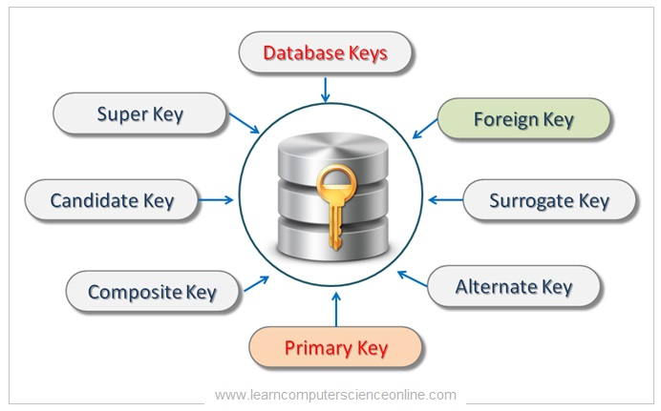
https://www.guru99.com/dbms-keys.html

Slide 50
Types of Keys in Database Management System
Super Key - A super key is a group of single or multiple keys which identifies rows in a table.
Primary Key - is a column or group of columns in a table that uniquely identify every row in that table.
Candidate Key - is a set of attributes that uniquely identify tuples in a table. Candidate Key is a super key with no repeated attributes.
Alternate Key - is a column or group of columns in a table that uniquely identify every row in that table.
Foreign Key - is a column that creates a relationship between two tables. The purpose of Foreign keys is to maintain data integrity and allow navigation between two different instances of an entity.
Compound Key - has two or more attributes that allow you to uniquely recognize a specific record. It is possible that each column may not be unique by itself within the database.
Composite Key - An artificial key which aims to uniquely identify each record is called a surrogate key. These kind of key are unique because they are created when you don't have any natural primary key.
Surrogate Key - An artificial key which aims to uniquely identify each record is called a surrogate key. These kind of key are unique because they are created when you don't have any natural primary key.

Slide 51
Types of Keys in Database Management System
Super Key - A super key is a group of single or multiple keys which identifies rows in a table.
Primary Key - is a column or group of columns in a table that uniquely identify every row in that table.
Candidate Key - is a set of attributes that uniquely identify tuples in a table. Candidate Key is a super key with no repeated attributes.
Alternate Key - is a column or group of columns in a table that uniquely identify every row in that table.
Foreign Key - is a column that creates a relationship between two tables. The purpose of Foreign keys is to maintain data integrity and allow navigation between two different instances of an entity.
Compound Key - has two or more attributes that allow you to uniquely recognize a specific record. It is possible that each column may not be unique by itself within the database.
Composite Key - An artificial key which aims to uniquely identify each record is called a surrogate key. These kind of key are unique because they are created when you don't have any natural primary key.
Surrogate Key - An artificial key which aims to uniquely identify each record is called a surrogate key. These kind of key are unique because they are created when you don't have any natural primary key.

Slide 52
Keys
Let K ⊆ R
K is a superkey of R if values for K are sufficient to identify a unique tuple of each possible relation r(R)
  Example: {ID} and {ID,name} are both superkeys of instructor.
Superkey K is a candidate key if K is minimal
Example: {ID} is a candidate key for Instructor
One of the candidate keys is selected to be the primary key.
  which one?
Foreign key constraint: Value in one relation must appear in another
  Referencing relation
  Referenced relation
  Example – dept_name in instructor is a foreign key from instructor referencing department

Slide 53
End

Slide 54
History of Database Systems
1950s and early 1960s:
  Data processing using magnetic tapes for storage
    Tapes provided only sequential access
  Punched cards for input
Late 1960s and 1970s:
  Hard disks allowed direct access to data
  Network and hierarchical data models in widespread use
  Ted Codd defines the relational data model
    Would win the ACM Turing Award for this work
    IBM Research begins System R prototype
    UC Berkeley begins Ingres prototype
  High-performance (for the era) transaction processing

Slide 55
History (cont.)
1980s:
  Research relational prototypes evolve into commercial systems
    SQL becomes industrial standard
  Parallel and distributed database systems
  Object-oriented database systems
1990s:
  Large decision support and data-mining applications
  Large multi-terabyte data warehouses
  Emergence of Web commerce
Early 2000s:
  XML and XQuery standards
  Automated database administration
Later 2000s:
  Giant data storage systems
    Google BigTable, Yahoo PNuts, Amazon, ..

